Slide 1
ONLINE FOOD ORDERING PORTAL

Slide 2
SUMMER TRAINING PROJECT
NAME: BAREDDY RAJA SHEKHAR REDDY
SECTION: K19AS
REGISTRATION NUMBER: 11908537
DOMAIN: WEB DEVELOPMENT
COURSE: FRONT-END DEVELOPMENT
UNIVERSITY: LOVELY PROFESSTIONAL UNIVERITY

Slide 3
ABSTRACT
ONLINE FOOD ORDERING SYSTEM is a website designed primarily for use in the food ordering industry. This system will allow hotels and restaurants to increase scope of business by reducing the labour cost involved. The system also allows to quickly and easily manage an online menu which customers can browse and use to place orders with just few clicks.

Slide 4
OBJECTIVE
The main objective of the online food ordering system is to manage the details of Item category, Food, Delivery address, Order. The purpose of the project is to build an application program to reduce the manual work for managing the Item category, Food, Customer, Delivery Address. It tracks all the details about the Delivery Address and Order.

Slide 5
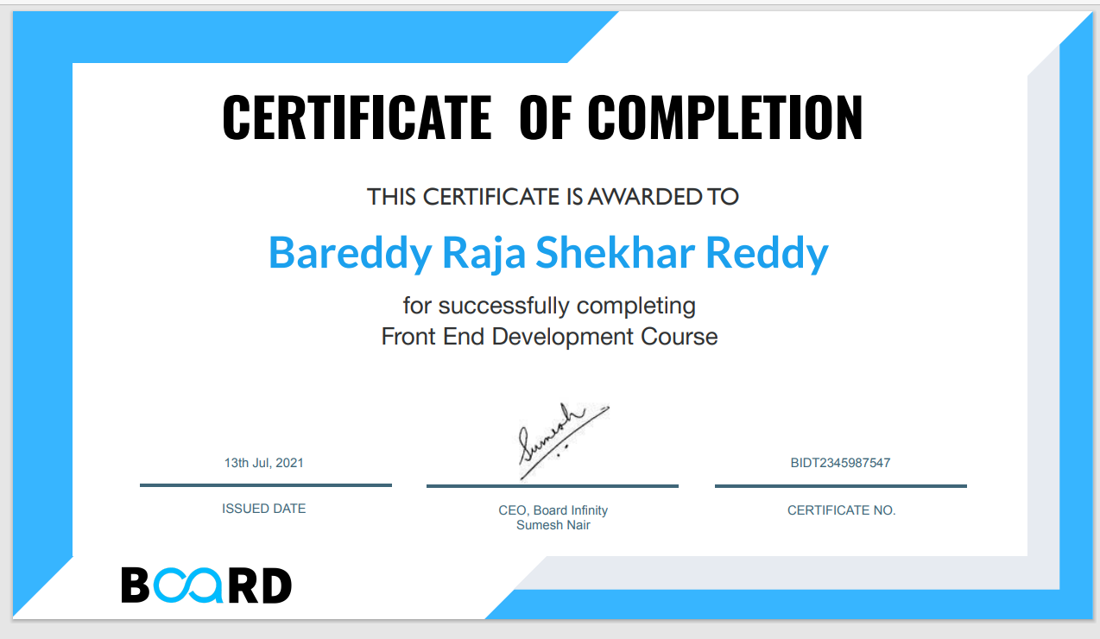
CERTIFICATE by “board infinity”

Slide 6
INTRODUCTION
The project Online Food ordering system is a web based application that allows the administrator to handle all the activities online quickly and safely. Using Interactive GUI anyone can quickly learn to use the complete system. Using this, the administrator doesn’t have to sit and manage the entire activities on paper, and at the same time, the head will feel comfortable to keep check of the whole system.
This study lays out a framework for a new system to be developed and brought to the market for maximum use and to create an avenue through the web where users can log on to our server and make a selection of whatever goods or food they like and subsequently pay via the internet. The following are the objectives this would bring:

Slide 7
INTRODUCTION CONTINUED…..
The home page of this web interfile provides an avenue where customers will be able to gather more and reliable information about what the fast food industry really does.
The products and services offered would provide the customers with all the different categories of available products that they can choose and select from.
This will provide a user friendly environment between the customer and employee thus increasing the efficiency of the food ordering system.
There will also be an online purchase form with which valued customers will be using to get in touch with any of their request whenever the need arises.
It will also help for easy retrieval of orders made by the customers

Slide 8
TECHNOLOGIES USED
The cornerstones of web development are CSS and HTML. You may create a website with only these tools.
CSS is used to style the visual layout of the webpage, while HTML provides structure.
HTML is the markup language that we use to structure and give meaning to our web content, for example defining paragraphs, headings, and data tables, or embedding images and videos in the page.
CSS is a language of style rules that we use to apply styling to our HTML content, for example setting background colors and fonts, and laying out our content in multiple columns.

Slide 9
PROJECT
This portal is different from other portals in the way of representing the foods items available. It contains an immediate option of returning to dashboard from any where in the website .This also contains an login page as a precaution that no one misuses our customer's account .This is a safety and secure feature added to the website login page .Due to this security feature our banking ids ,address, names and phone numbers are secured’ .

Slide 10
LOGIN PAGE
Here the customer can login into the online food shop through this login web page by providing his username and password .If the customer misses any info then there will be a warning indicating 'please fill up this field .
If the customer doesn’t have any account for the website. He/she can register by providing the details.
And here you can see the snapshot of the login page

Slide 11
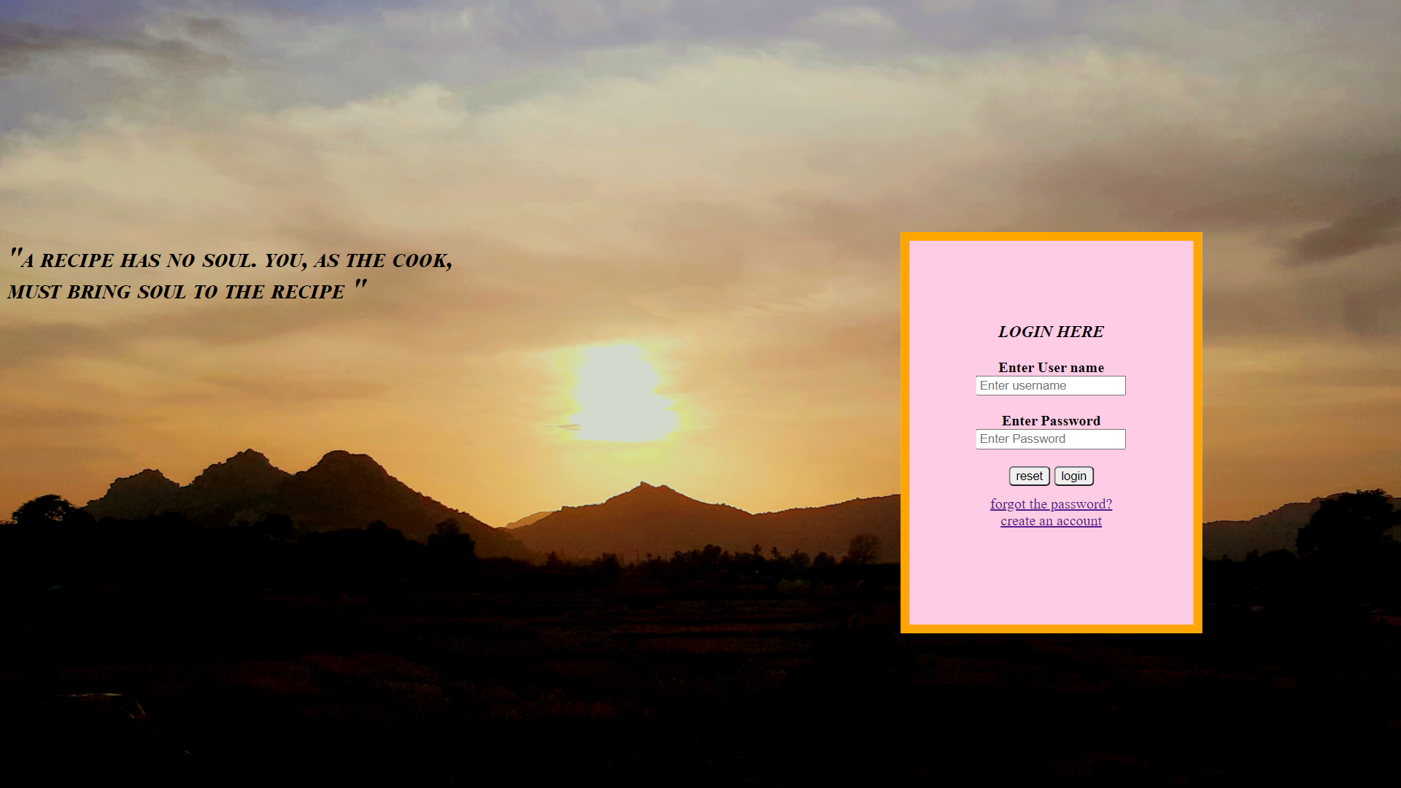

Slide 12
DASHBOARD
This index page appears after the login of the customer.
The customer can view the options he needed as menu and today's special. He can go to any of those options and order.
And here is the snapshot of dashboard

Slide 13
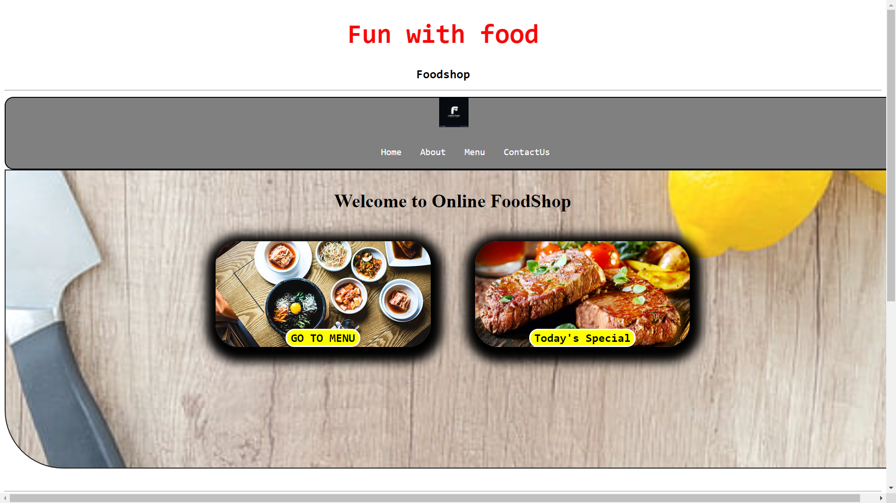

Slide 14
HOME
This webpage appears when the customer clicks on the home button available in the dashboard.
If the customer wants to visit our homepage. He just need to click the home option present in the dashboard. After, he can view the official home page of fun with food online food-shop
Here is the snapshot of the home page (brief description of the website)

Slide 15
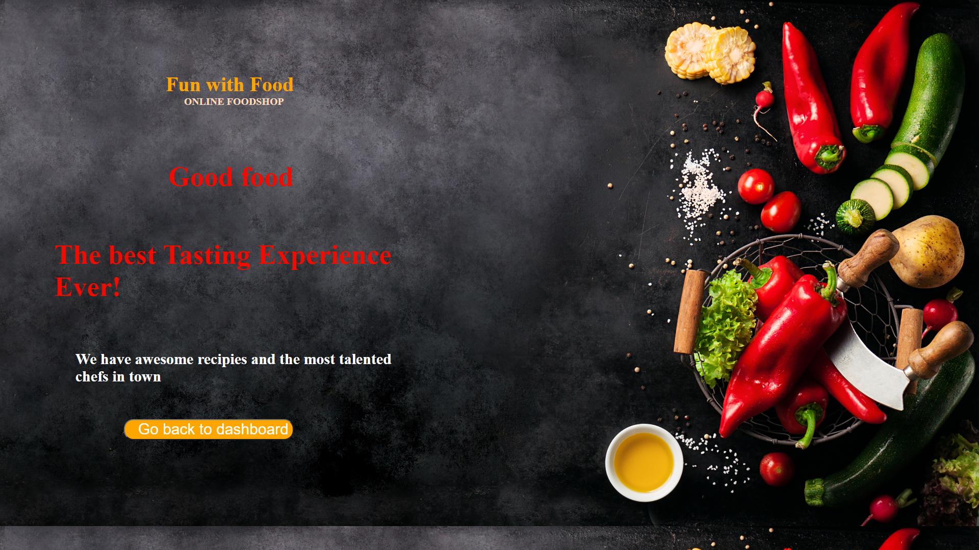

Slide 16
ABOUT US
If the customer wants to know about us. He just need to click on the about us option present in the top of the dashboard.
After, the customer can know about us (fun with food online food shop) .
Here the snapshot for the about us webpage.

Slide 17
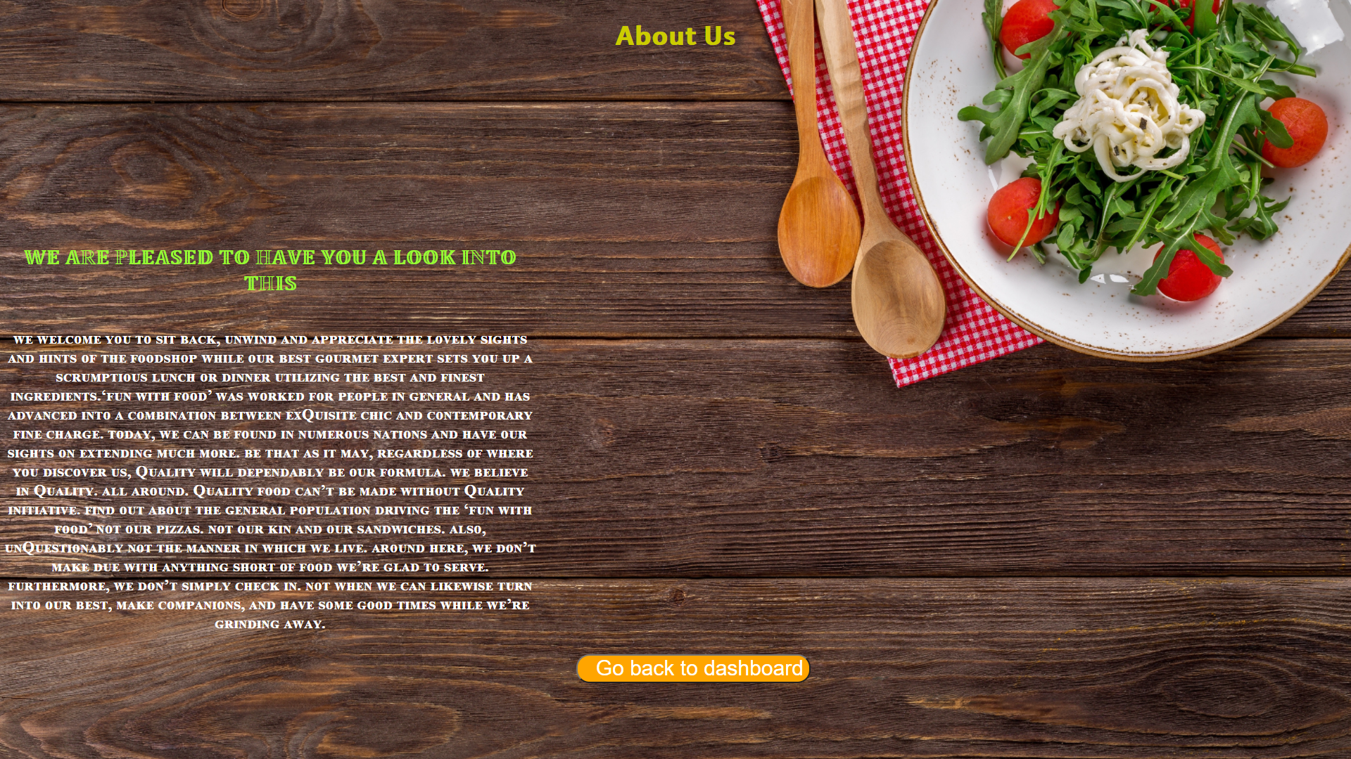

Slide 18
MENU
When customer visits our menu. He will be able to see all types of variety of food, that are able to deliver now.
A list of dishes available in a restaurant or the food available or to be served in a restaurant or at a meal for example “a dinner-party menu”.
He can order the dish by just clicking on the given option.
Here is the snapshot for the menu list.

Slide 19
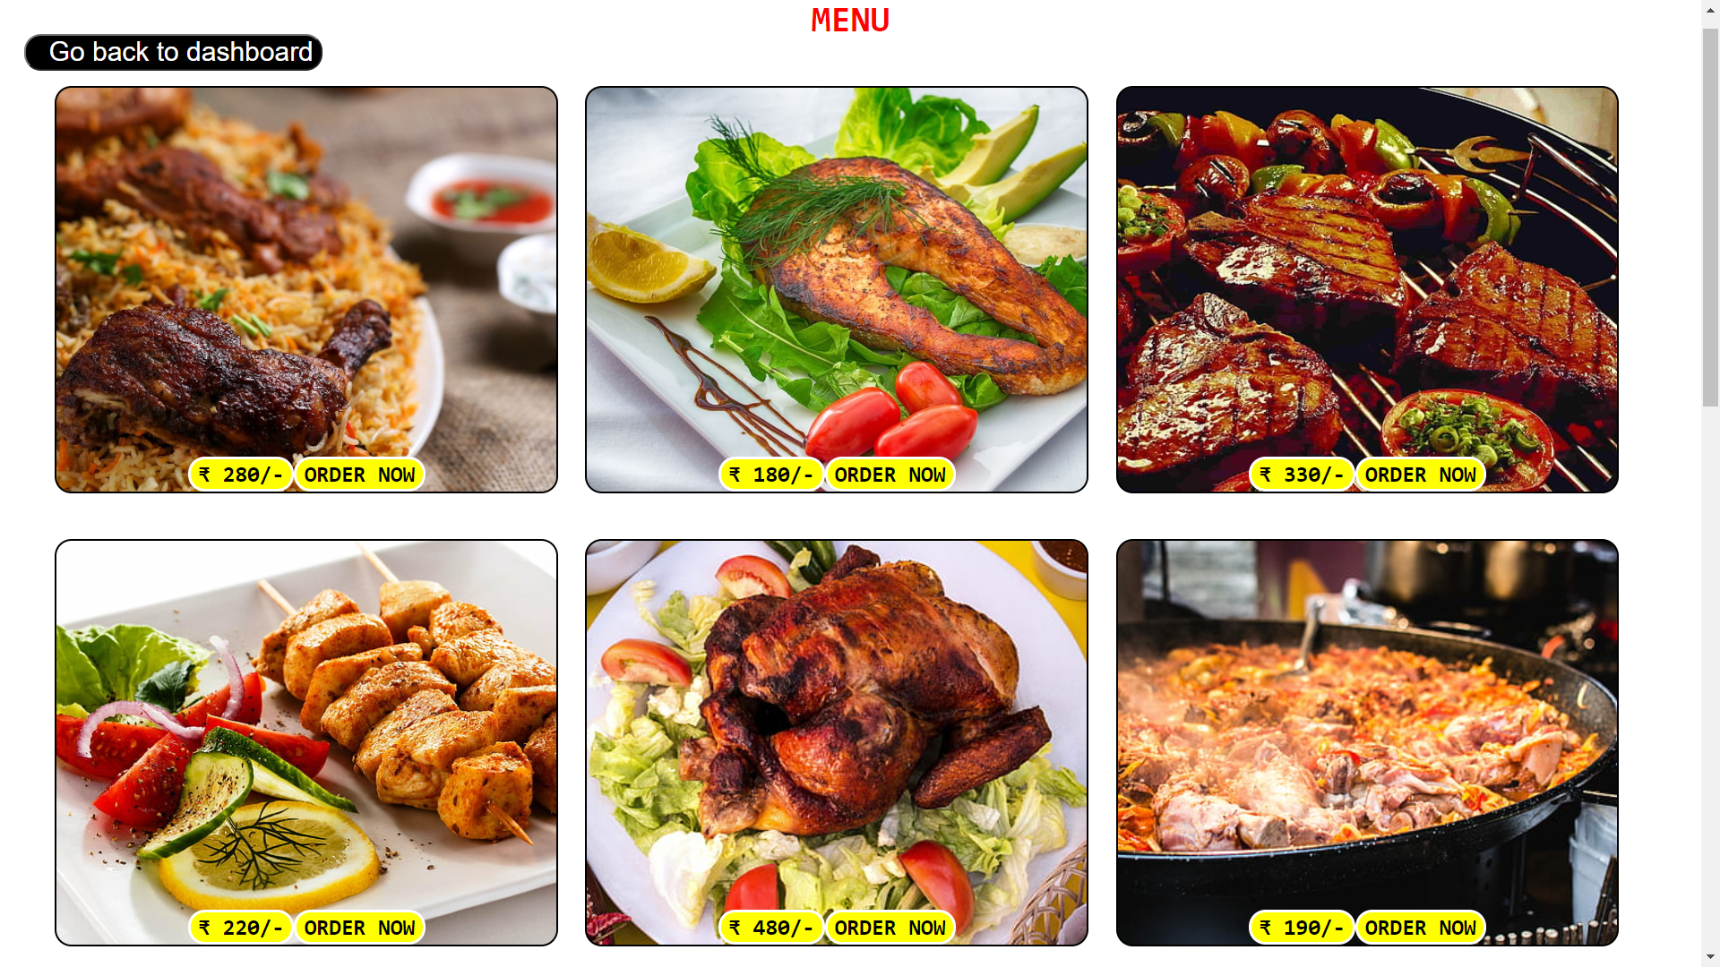

Slide 20
PAYMENT
When customer ordered a dish it will redirect to the payment web page and here customer can fill the required details to deliver the delicious food
A payment card is a payment card issued to users as a system of payment. It allows the cardholder to pay for goods and services based on the holder’s promise to pay for them
Here is the snapshot of payment page where the customer can provide his address and payment option.

Slide 21
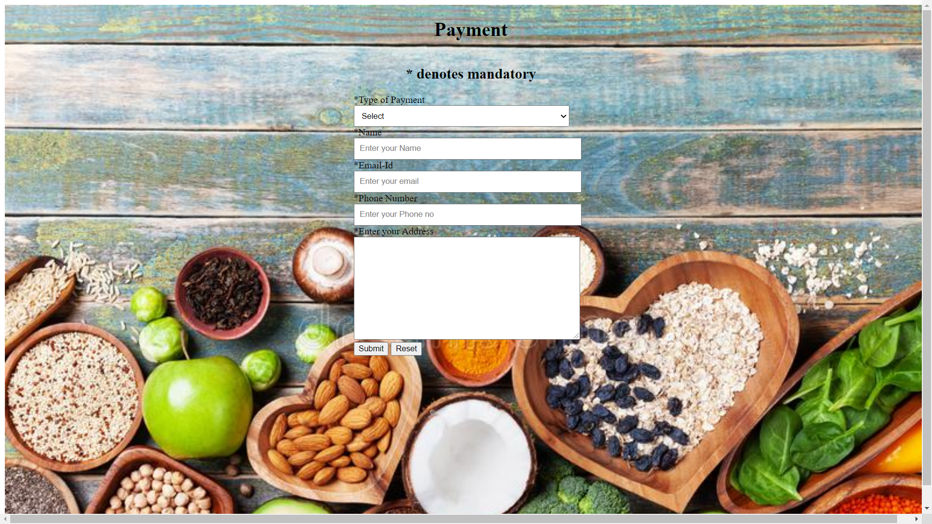

Slide 22
PAYMENT RECEIPT
When the customer fill up the required details in payment section and make a payment through his own choice.
He can get an payment successful notification when the customer clicks on the submit button present in the payment section.
Here is the snapshot of payment notification page.

Slide 23
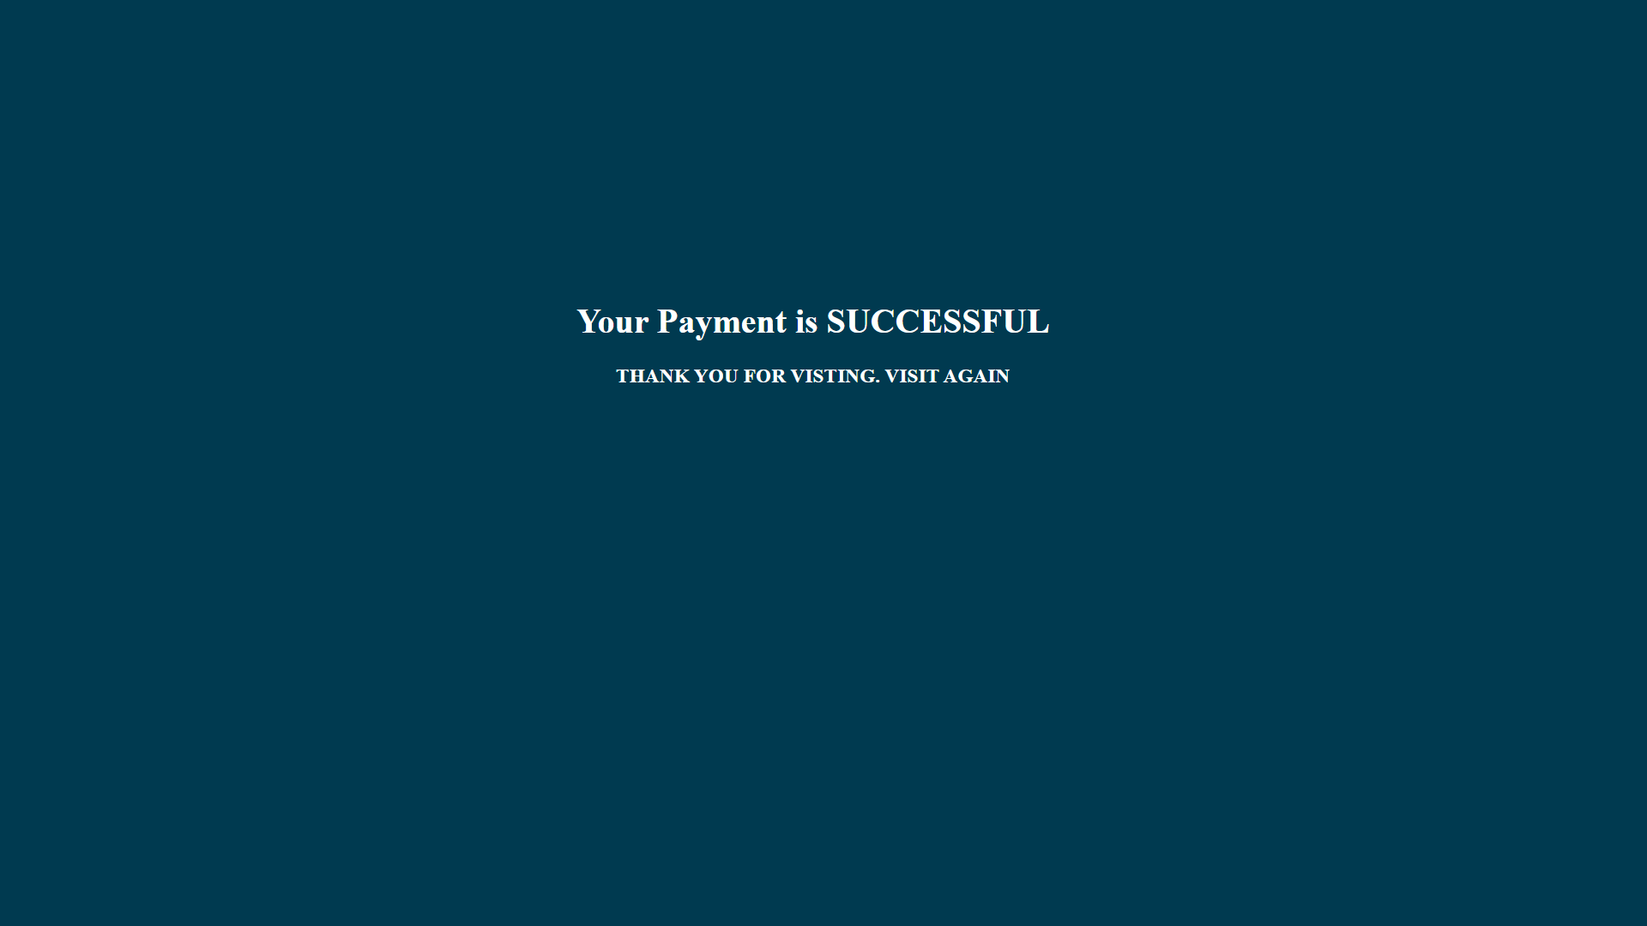

Slide 24
CONTACT US
This webpage appears when the customer clicks on the contact button present in the top of the dashboard.
When the customer have any issue regarding our site.
He can contact us by specifying the query .
Here is the snapshot of contact us page.

Slide 25
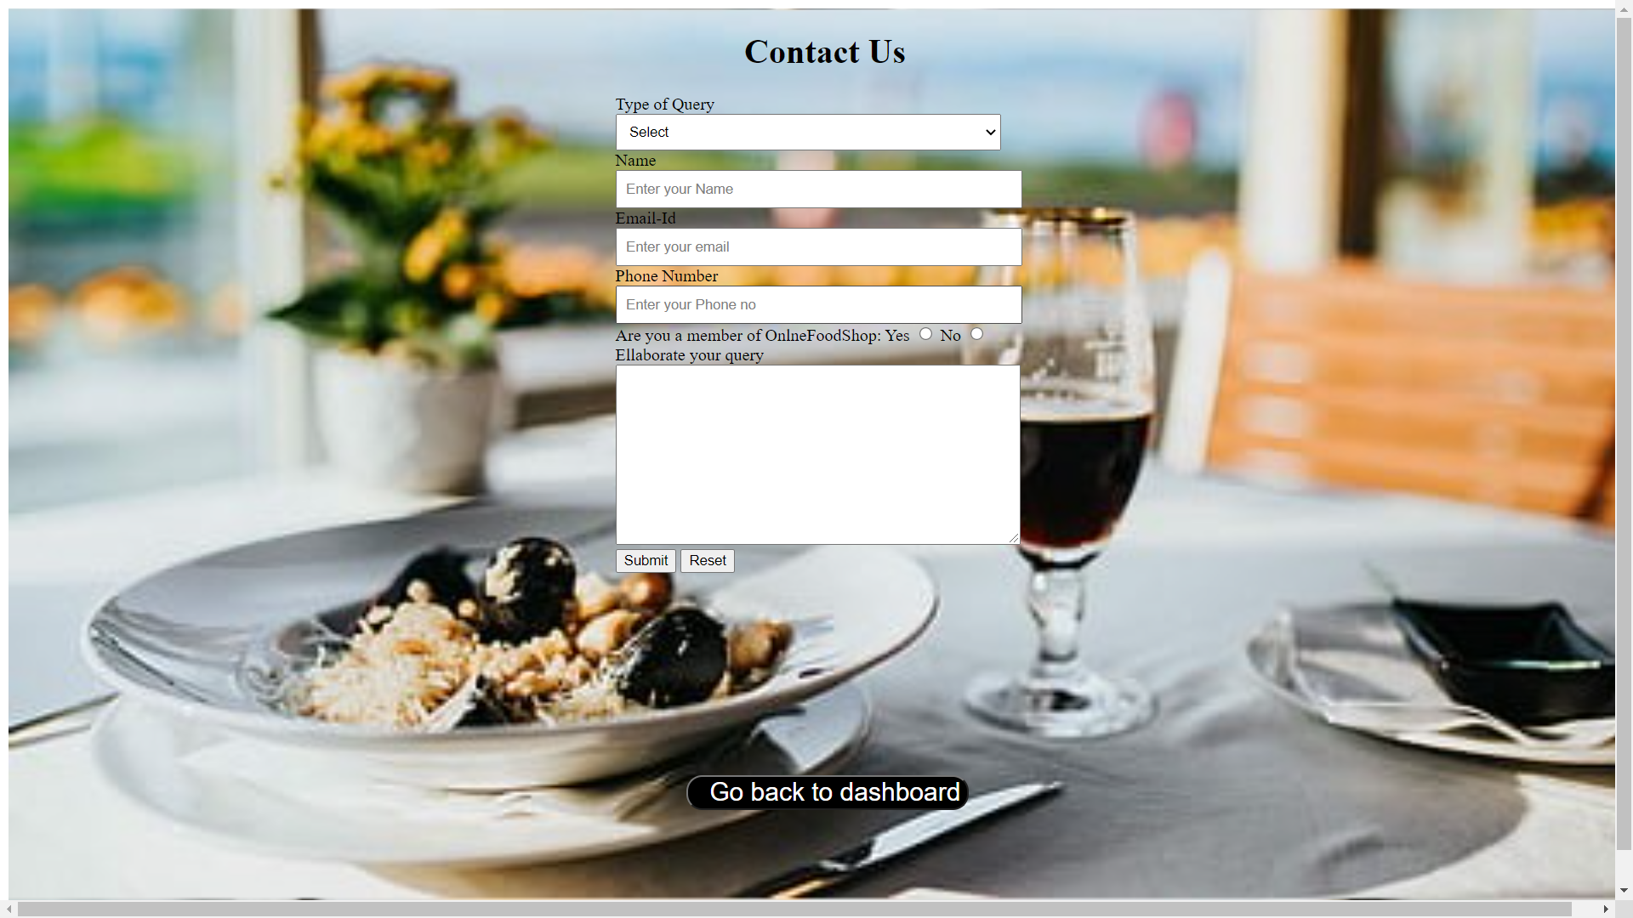

Slide 26
CONCLUSION
An online food ordering system is developed where the customers can make an order for the food and avoid the hassles of waiting for the order to be taken by the waiter.
Using the application, the end users register online, read the E-menu card and select the food from the e-menu card to order food online. This also helps the restaurant owners develop healthy customer relationships by providing reasonably good services.
Finally, in Online Food Ordering system, we have developed secure, user-friendly food ordering Management System. This System can take care of each member whether it is an Administrator or Customer.
Online Payment, Registration and cancellation make it easier to use. So, using this system will help in reducing the labor and provide more facility for Customer to like the services.

Slide 27
LEARNING OUTCOMES
Front-end web development is the development of the graphical user interface of a website, through the use of HTML, CSS and JavaScript, so that users can view and interact with that website. The challenge associated with front end of a website change constantly and so the developer needs to constantly be aware of how the field is developing.
What I have learnt from the course precisely:
❖ Learnt how to plan out a website
❖ Learnt the basics of optimizing the website.
❖ How to create a layout for webpages and the entire site
❖ How to add advanced features and elements to the web pages, including colors, text, images and more.
❖ Improved my problem-solving skills to become a stronger developer.

Slide 28
REFERENCES
❖ https://www.rapidtables.com/web/color/RGB_ Color.html
❖ https://www.w3schools.com/html/html_intro.as p
❖ https://www.w3schools.com/css/css_intro.asp
❖ https://developer.mozilla.org/en-US/docs/Learn/JavaScript/First_steps/What_is_JavaScript
❖ https://www.w3schools.com/howto/howto_web site.as

